Slide 1
Problem Statement
Cryptography Simulation with mbedTLS /OpenSSL Library

Slide 2
Unique Idea Brief (Solution)
To develop a cryptography simulation that demonstrates secure communication over UDP
using OpenSSL/ MbedTLS libraries which showcases the use of cryptographic protocols for
encryption,confidentiality.
Unique Aspects
Security protocol implementations like SIGMA Protocol.
Multi-Role simulation
Password-protected keys
Interactive Simulation
Real-Time communication testing

Slide 3
Features Offered
It provides a comprehensive SSL/TLS solution
and makes it easy to include cryptographic and
SSL/TLS capabilities in their software and
embedded products.As an SSL library,it provides
an Intutive API, readable source code and a
minimal and highly configurable code footprint

Slide 4
Process Flow
Exercise – Creating Digital Certificates
Installation of OpenSSL Library and setting up the environment configuration.
Generate a private key:
Generated an RSA private key with a size of 3072 bits.
2.Create a certificate signing request
Created a Certificate Signing Request using the generated private key and
specified the SHA-384 hashing algorithm
3.Generate the Self-Signed Certificate:
Created the self-signed root certificate using the CSR and private key.
Set the serial number to 01 during the certificate creation process.

Slide 5
Commands used for Task : creating digital certificates
Generate a 3072-bit RSA private key.
Command :openssl genpkey -algorithm RSA -out rootCA.key -pkeyopt rsa_keygen_bits:3072
2) Create a Configuration File.
3) Generate the Self-Signed Certificate:
Use the configuration file to create a self-signed root certificate with SHA-384 and a serial number of 01.
Command : openssl req -x509 -new -nodes -key rootCA.key -sha384 -days 3650 -out rootCA.crt -config openssl.cnf -set_serial 01.
4) Verify the Certificate.
Command: openssl x509 -in rootCA.crt -text –noout.
(Same has been done for Generating RSA keypair of size 3072 with SHA384 for “Alice” and sign with root CA and set serial number 02
Generate RSA keypair of size 3072 with SHA384 for “Bob” and sign with root CA and set serial number 03)

Slide 6
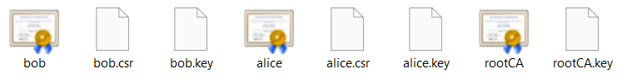
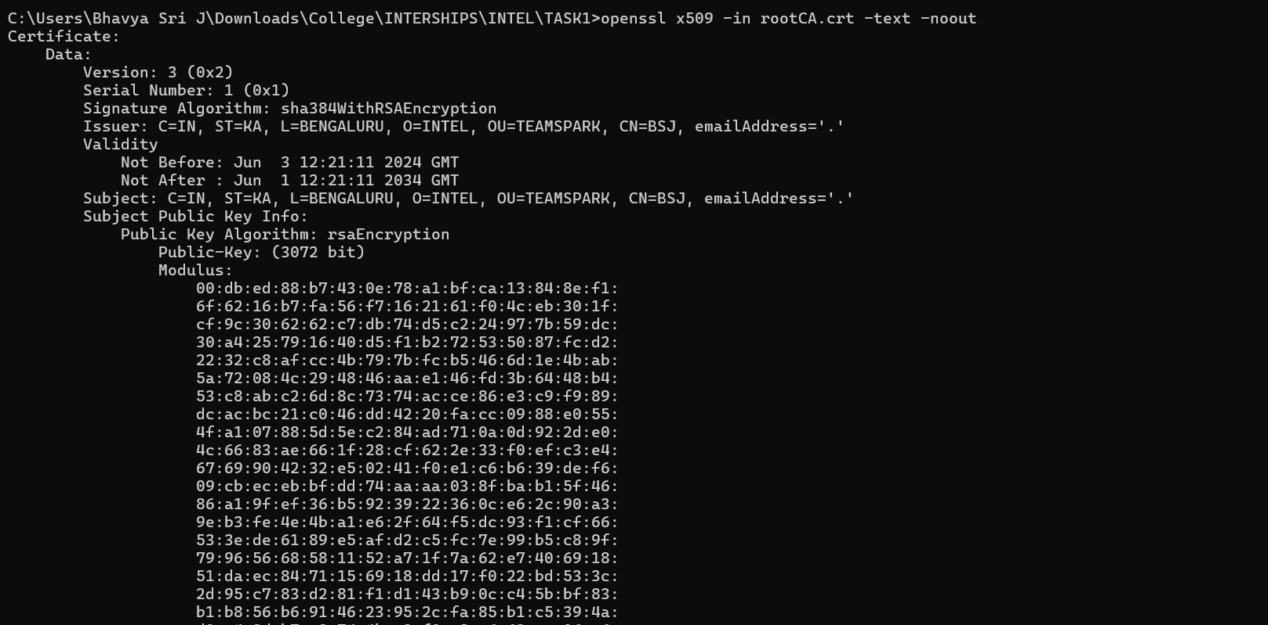
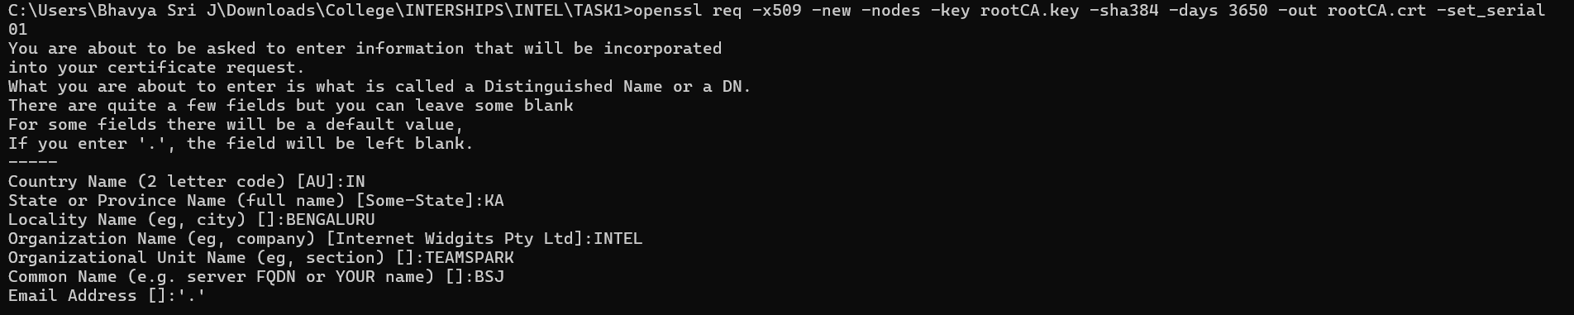
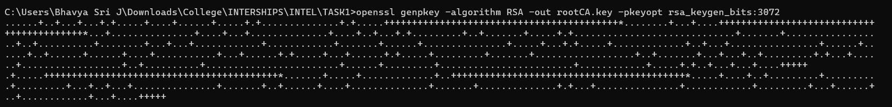
Images of Digital Certificates

Slide 7
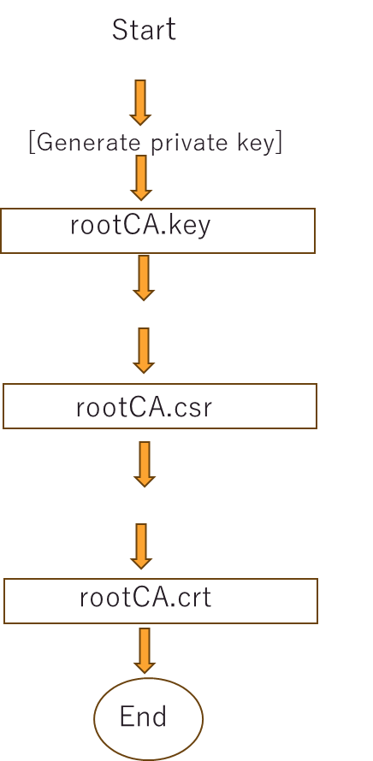
Architecture Diagram

Slide 8
Technologies used
Open SSL
Is an open-source command line tool that is commonly used to generate private keys,
create CSRs, install your SSL/TLS certificate, and identify certificate information.
Visual Studio
Is an integrated development environment (IDE) developed by Microsoft. It is used to
develop computer programs including websites, web apps, web services and mobile apps
Wire shark
Powerful and widely-used network protocol analyzer. It enables users to capture and
interactively browse the traffic running on a computer network

Slide 9
Team members and contribution
Team Member 1 : Dhanashri Sanjay Kate]
Contributions:
Contributed to CryptoWrapper.h, main.cpp in crypto_test project code implementation.
Documentation of implementation and results.
Managed project timelines.
[Team Member 2 : Janhavi Rajkumar Patil]
Contributions:
Implementation of OpenSSL command scripts for key and certification generation.
Contributed to server_session.cpp and main.cpp in udp_party project code implementation.
Documentation of the scripts/commands of digital certificates.
[Team Member 3 : Darshana Vinod Katre] Contributions:
Generation of private key and CSR for the client (Bob).
Contributed to completing crypto_wrapper_openssl.cpp implementation.
Documentation of the process for generating client keys and certifications

Slide 10
Conclusion
This project represents a practical approach to understanding and demonstrating cryptography principles and algorithms to secure communication between two parties.
Key Highlights
Utilizes the SIGMA protocol and hybrid encryption to ensure mutual authentication, data confidentiality, and protection against various attacks like man-in-middle etc.
Simulates both server and client roles, showcasing the full lifecycle of secure communication setup and management.
Demonstrates practical application through real-time communication testing.
By working collaboratively and dividing tasks among team members, the project ensures balanced contributions and foster a deeper understanding of cryptographic implementations

